Slide 1

What Drives the Mood
and Reach of a Post?
Social Media Sentiment Analysis · 732 posts on Instagram, Twitter and Facebook
28.10.26
Notes:
Opening, about 20 seconds. The question: what drives the mood of a social media post, and what drives its reach? Dataset is the Kaggle Social Media Sentiments Analysis set: 732 posts, each with text, a sentiment label, timestamp, platform, hashtags, Likes, Retweets and country. I’ll go through cleaning, sentiment, time, engagement, hashtags and geography, then the takeaways.

Slide 2
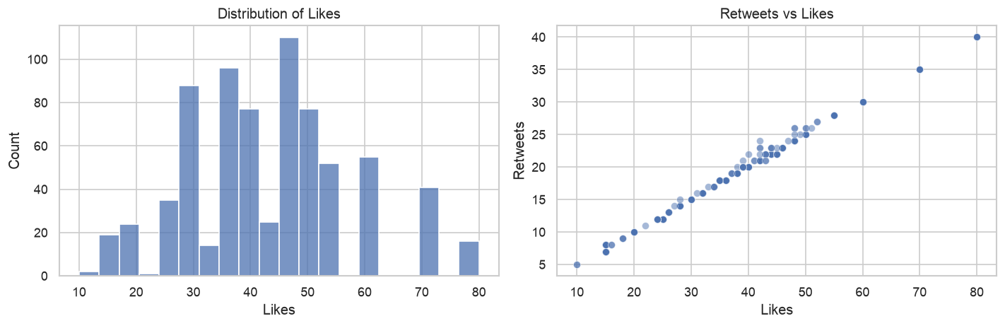
Skewed Data, One Redundant Metric
PART 01 · DATA
83%
39%
279 → 191
r = 0.998
of posts from 5 of 33 countries
of posts from 2023 alone
labels after stripping spaces
Likes vs Retweets → use Likes only
No missing values; 22 duplicate rows kept and noted
02
Notes:
About 40 seconds. Cleaning: dropped two leftover index columns and stripped extra whitespace, which collapsed 279 sentiment labels into 191. No missing values; 22 duplicate rows, kept but noted. The data is skewed: 83% of posts come from five countries (USA, UK, Canada, Australia, India) and 39% from 2023. Platforms are balanced: Instagram 258, Twitter 243, Facebook 231. Key point: Retweets are almost a copy of Likes, correlation 0.998, and exactly half of Likes for 59% of posts. So from here on, engagement means Likes.

Slide 3
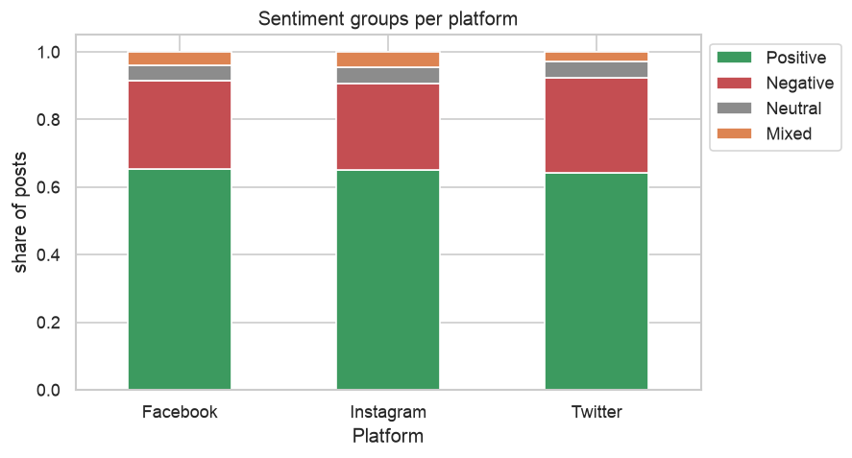
191 Labels, Four Groups, One Mood
PART 02 · SENTIMENT
65%
Positive After Grouping
Negative 27% · Neutral 5% · Mixed 4%. 79 labels appear only once.
The mix is the same on every platform: 64–65% Positive, 26–28% Negative.
Every label mapped by hand to Positive, Negative, Neutral or Mixed
03
Notes:
About 40 seconds. 191 labels are too many to compare, so I mapped each one by hand into four groups. The result is heavily positive: 65% Positive, 27% Negative, 5% Neutral, 4% Mixed. That imbalance matters for any classifier later. And the emotional landscape does not depend on the platform — Facebook, Instagram and Twitter all sit at 64–65% Positive.

Slide 4
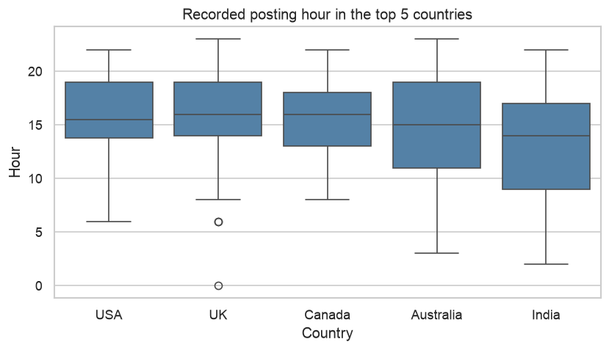
Local Time, and a Mood That Ignores It
PART 03 · TIME
USA and India are ~10 hours apart, yet their average posting hours are 15.6 and 13.4. If it were UTC, India would shift by ~10 h.
Posts peak afternoon and evening. Positive share stays at 64–67% in every part of the day.
Outliers: Sep 2023 is 44% Negative, Oct 2023 is 29% Neutral — a batch of posts, not a season.
Middle half of posts in every top-5 country falls between ~9:00 and 19:00
04
Notes:
About 45 seconds. The timestamp has no time zone, so I tested it. If it were UTC, countries ten hours apart would post at very different recorded hours. They don’t: USA averages 15.6, India 13.4, and in all five top countries the middle half of posts sits between roughly 9 and 19. So it’s local time and we can read the hour as time of day. People post in the afternoon and evening, but the mood barely moves with time of day. The only odd months are September and October 2023, which look like one batch of posts rather than a seasonal effect.

Slide 5
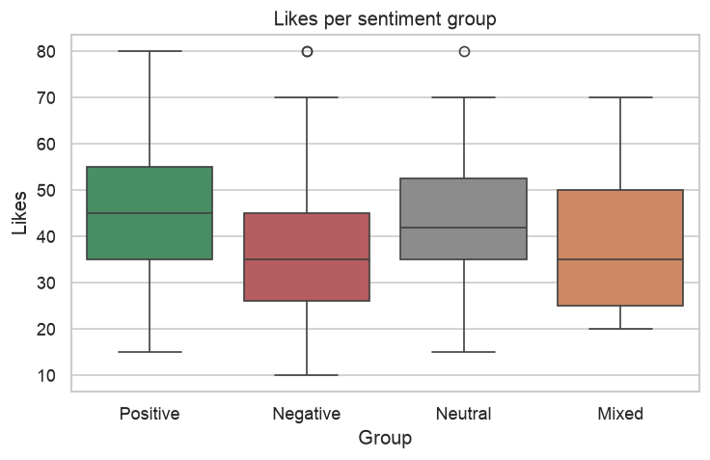
Positive Posts Earn More Likes
PART 04 · ENGAGEMENT
+10
Mean Likes, Positive vs Negative
46.1 vs 35.9. Smaller lifts: Instagram 45.1 vs ~42 elsewhere; evening 46.6 vs morning 39.2.
670 users for 732 posts, none with more than 3 — no influencers skew the numbers.
All correlations with Likes are weak: positive 0.31, text length 0.20, hour 0.20
05
Notes:
About 40 seconds. Engagement is measured with Likes only. Positive posts average 46.1 Likes, Negative ones 35.9 — about a 10-Like gap, the biggest effect in the data. Instagram gets slightly more Likes, and evening posts beat morning ones, 46.6 vs 39.2. There are 670 users for 732 posts and nobody posts more than three times, so there are no influencers. Correlations are all weak, so no single feature explains Likes.

Slide 6
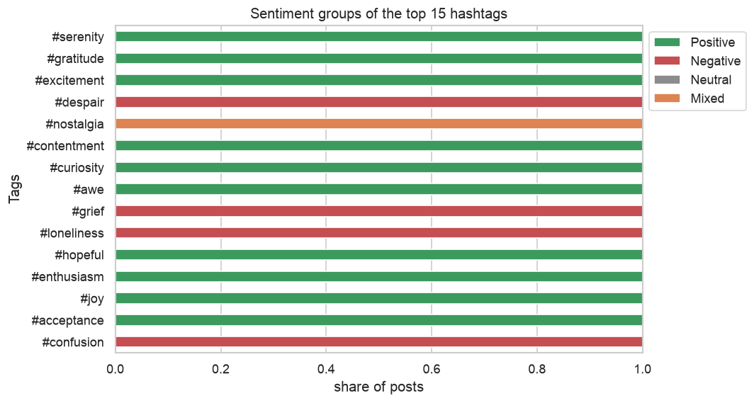
Hashtags Give the Answer Away
PART 05 · HASHTAGS
71%
First Hashtag Equals the Label
Every top-15 hashtag belongs 100% to one sentiment group. 975 hashtags, 773 used once.
So: never a model input — it would be data leakage.
Top tags: #serenity, #gratitude, #excitement — the labels themselves
06
Notes:
About 40 seconds — this is the slide to slow down on. The most common hashtags are just the sentiment labels: #serenity, #gratitude, #excitement. For 71% of posts the first hashtag equals the label, and every top-15 hashtag is 100% one sentiment group. If we fed hashtags into a sentiment model it would look great and learn nothing — that’s data leakage. Hashtags must be excluded.

Slide 7
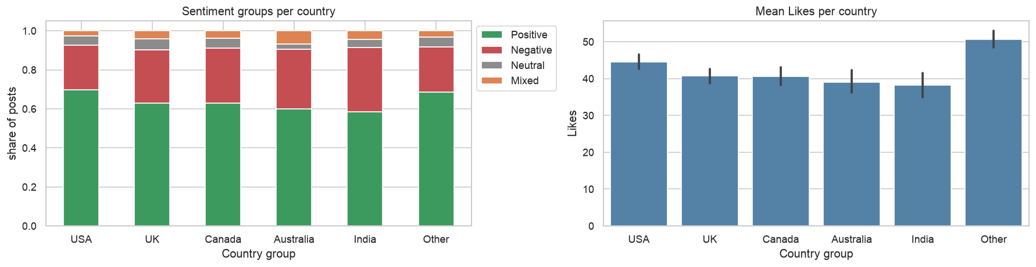
Mood Varies by Country, Not Platform
PART 06 · GEOGRAPHY
USA 70%
India 59%
~51 Likes
Positive — the most upbeat country
Positive; India and Australia ~31–33% Negative
for smaller countries vs 38–44 in the top 5
Non-top-5 countries grouped as “Other”; platform × country cells hold only 19–72 posts
07
Notes:
About 35 seconds. Unlike platform, country does shift the mood: USA is 70% Positive, while India is 59% and Australia 60%, with about a third of their posts Negative. Smaller countries grouped as Other actually get more Likes, around 51 vs 38–44. There are also hints of platform-by-country interaction — in Canada, Facebook is 86% Positive but Instagram only 42% — but each cell has only 19 to 72 posts, so treat that as a hint, not a conclusion.

Slide 8
What It Means for a Model
PART 07 · TAKEAWAYS
Findings
For Modeling
01. 65% Positive, identical across platforms and times of day.
01. Drop hashtags as input — they leak the label.
02. Handle class imbalance (65 / 27 / 5 / 4).
02. USA most positive; India and Australia least.
03. Use Likes only; Retweets are redundant.
03. Positive posts get ~10 more Likes; evening and Instagram slightly more.
04. Expect weak signals: no single feature explains Likes.
04. Timestamps are local; Sep/Oct 2023 are batch anomalies.
Thank you — questions?
08
Notes:
About 40 seconds. To sum up: mood is overwhelmingly positive and doesn’t depend on platform or time of day, but it does vary by country. Positive posts earn about 10 more Likes. Timestamps are local time, and September and October 2023 look like batch artifacts. For a model: exclude hashtags because they leak the label, handle the class imbalance, use Likes as the single engagement target, and expect weak individual signals. Thank you — happy to take questions.

